Slide 1


FCST models and accuracy measurement Shawn 2022/10

Slide 2

Agenda
Part1 Evaluation Methodology
Part2 Model introduction
Part3 FCST OKR
Part4 Accuracy measurement
Part5 Model optimization

Slide 3

Part1
Evaluation Methodology
Our evaluation is always based on historical actual data

Slide 4
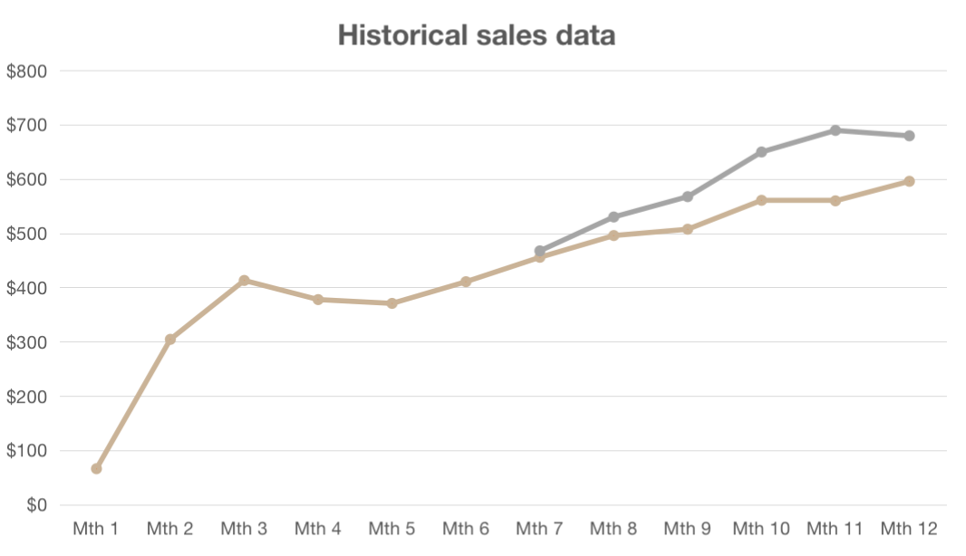
Evaluation-Backtest
Conditioning range
Forecast horizon
—Actual sales
—Forecast sales
Conditioning range
How much historical data is used for training
Backtest
Forecast point
When to make predictio
Forecast horizon
How long to predict in the future
Forecast point
Conditioning range
Forecast point
Forecast horizon
Manual FCST |  | 2021-09-30 | 2021-10-01～2021-12-31[3 months]
System MLP | 2018-01~2021-09 | 2021-09-30 | 2021-10-01～2021-12-31[3 months]
System NP | 2018-01~2021-09 | 2021-09-30 | 2021-10-01～2021-12-31[3 months]

Slide 5
Part2
Model introduction
For single variable multi product time series prediction of product granularity, deep learning is our first choice

Slide 6
Algorithm comparison
Classical algorithm
Machine learning
Deep learning
 | 指数平滑、ARIMA、WMA... | Tree model... | NeuralProphet、DeepAR...
Accuracy | low | higher | higher
Stability | high | lower | lower
Adjustability | low | higher | higher
Forecast mode | Local | Global | Global

Slide 7
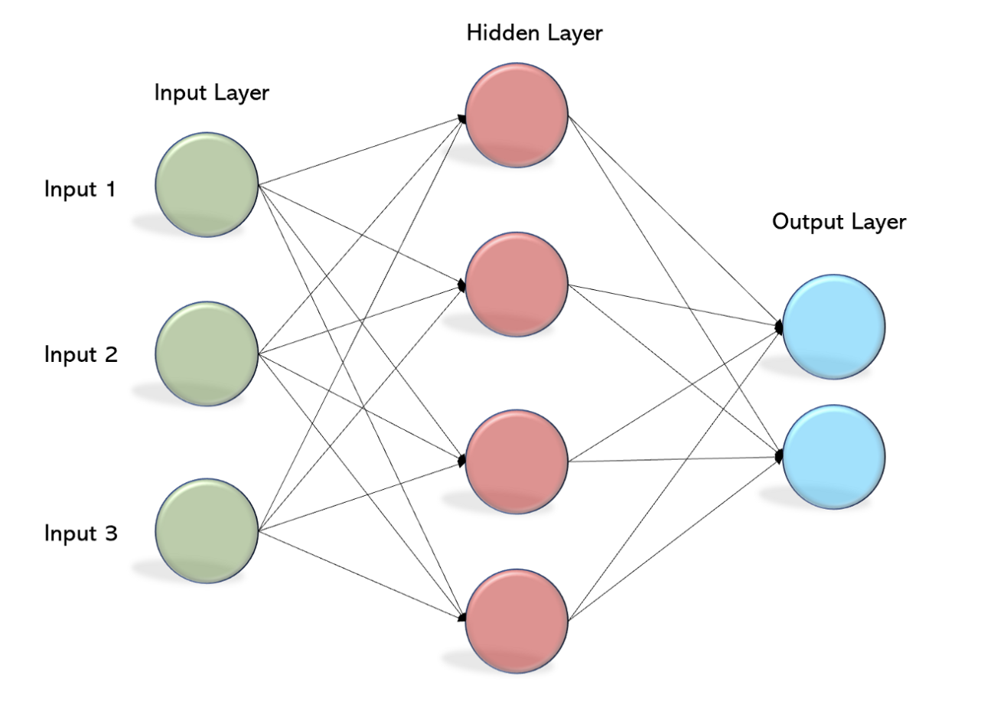
MAIN IDEA
MLP (Multi-Layer Perceptron)
MLP attempts to simulate the event space through complex matrix calculation. Theoretically, when the model is complex enough, it can simulate any event
We input the data of the past N months as N inputs, and output the prediction window value after being processed by the Hidden Layer

Slide 8
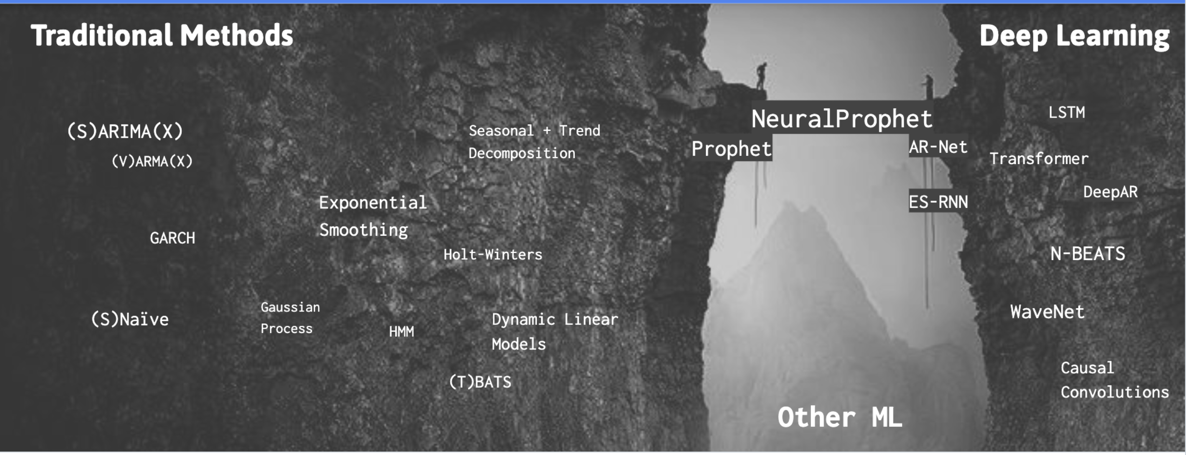
Facebook’s Prophet + Deep Learning = NeuralProphet
NeuralProphet is more than the Neural evolution of Prophet.
Global modeling is provided in April 2022
NP (NeuralProphet)

Slide 9
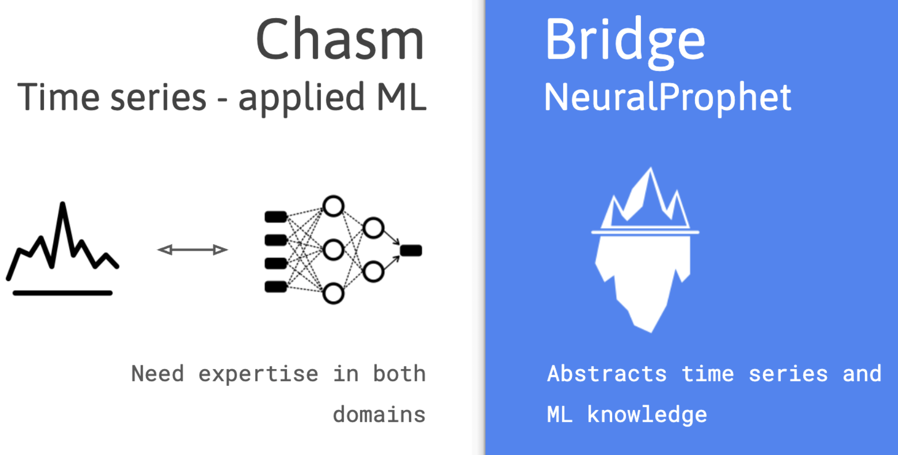
NP (NeuralProphet)
Trend
Seasonality
Auto-Regression(Rolling)
Lagged Regressors
Events(特殊事件节点)
Future Regressors(未来协变量)

Slide 10

Part3
FCST OKR
YTD Accuracy、
Written Month Accuracy

Slide 11
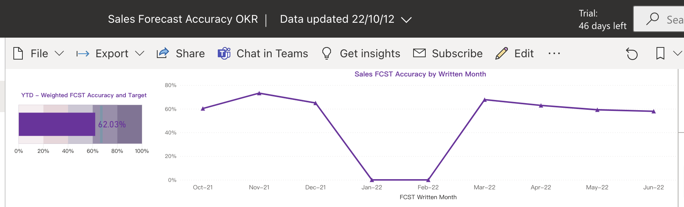
OKR Description
【Month】：单次模型的准确率(1-MAPE)
【YTD】：近一年模型所有预测结果的平均准确率
实际销量统计逻辑： 使用线性销售假设对缺货天数小于15天的月份进行销量修正
缺货月份 | 缺货天数 | 有货日平均销量 | 当月销量
一月 | 10 | 20 | 20*31=620

Slide 12
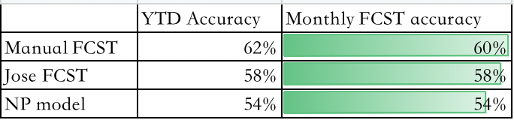
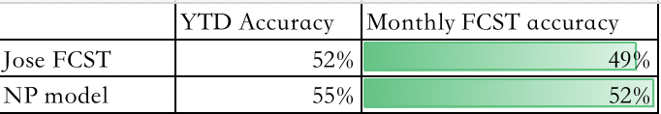
OKR Value
Conditioning range
Forecast point
Forecast horizon
Manual FCST |  | 2021-09-30 | 2021-10-01～2021-12-31[3 months]
System MLP | 2018-01~2021-09 | 2021-09-30 | 2021-10-01～2021-12-31[3 months]
System NP | 2018-01~2021-09 | 2021-09-30 | 2021-10-01～2021-12-31[3 months]
asin pool: manual fcst products 1000+
asin pool: ongoing products 1w+

Slide 13
Part4
measurement
discussion
Each evaluation method has limitations

Slide 14
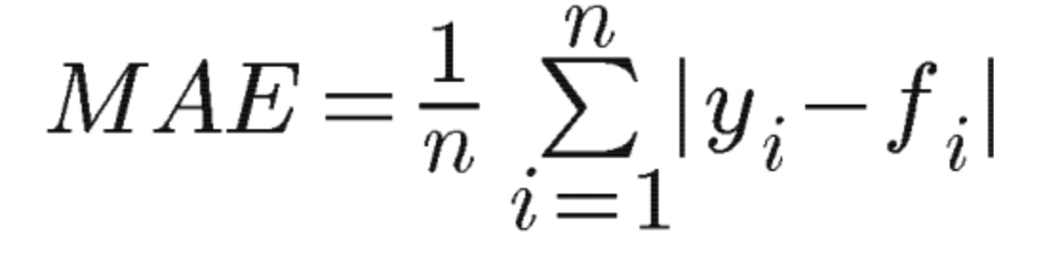
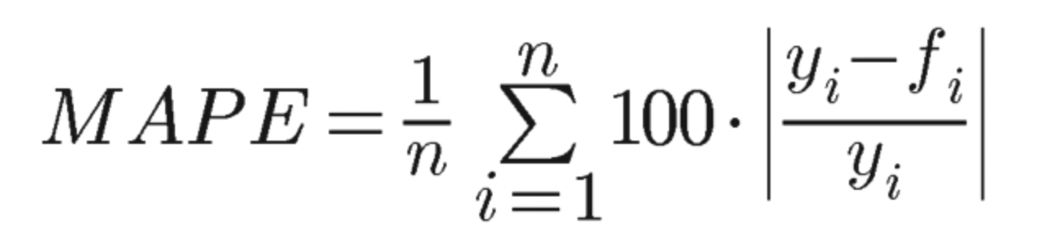
index List
指标 | 公式 | 侧重点
YTD | sum(实际值-abs(预测值-实际值))/sum(实际销量) | 放大极端偏大值的误差影响
Month Acc | 1- sum(abs(预测值-实际值))/sum(实际销量) 【1-WMAPE】 | 考虑实际销量的加权准确率
MAE |  | 衡量预测值和真实值的绝对差距
MAPE |  | 衡量样本整体的误差情况
R2 |  | 相对预测均值的拟合情况
实际值 | 预测值 | abs(预测-实际) | 实际-abs() | YTD
100 | 300 | 200 | -100 | ACC:0%
100 | 50 | 50 | 50
100 | 50 | 50 | 50

Slide 15
Part4
Model optimization

Slide 16
Part1 数据层面
Part2 模型层面
一、时序样本预处理环节(可复用于后续其他算法)
1.变点检测及处理（异常检测）：
目的： 通过将时序数据拆解来扩充样本量及提高模型性能
a.通过斜变量识别 b.通过滑动窗口前后统计指标变化识别
2.样本聚类分层(用于下游同一模型或多个模型，分场景建模)：
a.根据业务规则、品类规划. b.构建特征(时序统计指标)+聚类（重点在输入样本的特征，口径）
二、通过badcase对算法超参及建模pipeline优化
1.超参数调整
以当前NP算法为例，一方面prophet算法常规的突变点、时序分解等超参调整， 另一方面从底层涉及的MLP算法进行超参调整
2.预测模式调整
对算法的预测模式(迭代、直接、迭代+直接预测模式；点估计、概率预测、区间预测)及对应输入/输出后处理进行调整
Part3 多模型集成
三、引入其他适用不同场景的算法
1.当前单变量多元序列预测问题
引入AWS DeepAR pluse作为现有商业化产品的baseline；引入其他DL时序算法，例如TFT\DeepAR等
2.未来多变量多元序列预测问题
在前述DL和时序特征的基础上，进一步构造其他协变量衍生特征，引入Tree model
3.聚类簇的多模型融合

Slide 17
GZ ENG
Application Engineer - Machine Learning : Shawn
THANKS

